Slide 1


WELCOME TO
BTECH STUDIOS!!

Slide 2
OUR SERVICES
1
WEB DESIGN& DEVELOPMENT
LOGO DESIGN
2
3
GRAPHICS DESIGN
IT SUPPORT
4
5
VIDEO& PHOTO EDITING

Slide 3
WEB DESIGN& DEVELOPMENT
1
WEB DESIGN
WEB DEVELOPMENT
WEB DEPLOYMENT
WEB HOSTING

Slide 4
PLAN
CSS
WEB
DESIGN
FINAL
DESIGN
HTML

Slide 5
LOGO DESIGN
COMPANY AND B/S LOGO
3D LOGOS
BRANDING
TOOLS
COMPANY PROFILE
BUSINESS CARDS
COMPANY LOGOS
COMPANY BRANDING AND MARKETING
MODERN 3D LOGOS
COMPANY BRANDING
ADOBE PREMIER
CANVA

Slide 6
CYBER SERVICES
2

Slide 7
CV WRITING
GOVERNMENT SERVICES
Modern and professional CV writing
KRA pin
NSSF
Driving License
SHA
Passport applications
E-citizen
IT SUPPORT
COMPUTER AN PHONE TROUBLESHOOTING
EMAILING
ACCOUNT CREATION
EMAIL RECOVERY
PHONE REBOOT
IT SUPPORT
ONLINE SERVICES

Slide 8

COMPUTER GUIDANCE

Slide 9
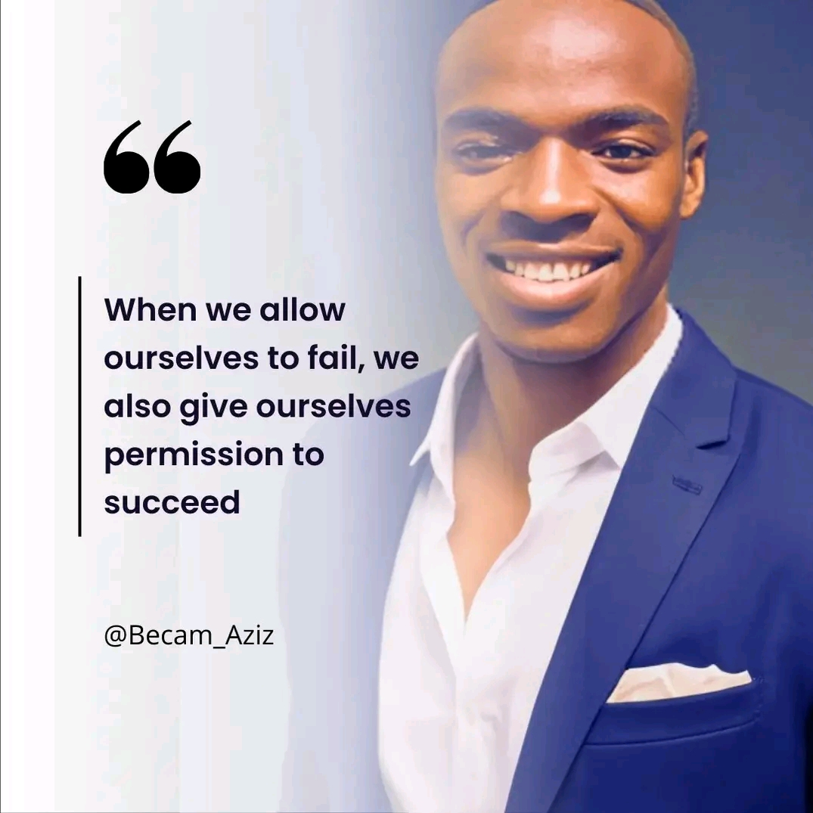
BECAM W. AZIZ
FOUNDER AND CEO

Slide 10
VIDEO AND PHOTO EDITING
3

Slide 11
CONTENT EDITING
CONTENT WRITING
SOCIAL MEDIA REELS
PROFESSIONAL CONTENT WRITING
VIDEO EDITING
PHOTO AND VIDEO POSTING
MODERN CLASS EDITING
WEB AND SOCIAL MEDIA
VIDEO RECORDING
NETWORKING
GROUND RECORDING
MARKETING BOTH LOCALLY AND INTERNATIONAL
SOCIAL MEDIA MARKETING
PHOTO EDITING
SEO AND META BUSINESS SUIT
SATISFYING PHOTO EDITING

Slide 12
SEO AND DIGITAL MARKETING
IT SUPPORT
CYBER SERVICES
WEBSITE DESIGN

